Slide 1

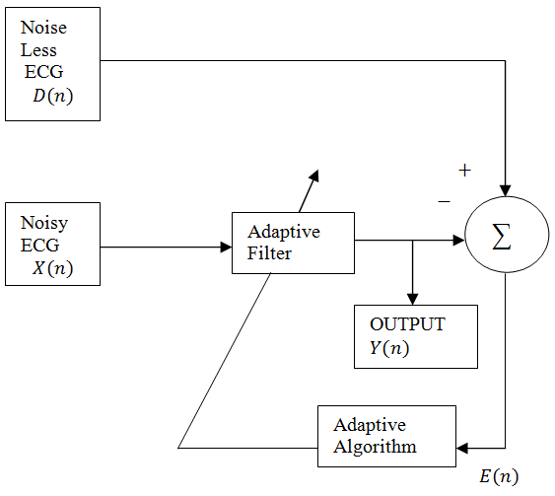
NOISE CANCELLATION IN ECG SIGNAL
Context: Noise in ECG signals can lead to inaccurate heart diagnoses, causing delays in medical interventions. Current noise reduction methods are often expensive, complex, or prone to error. A machine learning-based system for real-time, automatic noise cancellation in ECG signals is essential for more reliable and accurate heart monitoring.
Block Diagram:
Problem Statement: Develop a real-time ECG noise cancellation system to enhance heart rate monitoring by removing interference, ensuring accurate diagnostics and early heart condition detection
Deliverables :
Cancelling and ensuring robustness of noise
Validating using different and various kind of noise.
able
Training / Pre-Requisites:
Understanding of Adaptive LMS filters, MATLAB and Filter design.
Starter Reference Material
R. B. Govindan, K. Narayanan, and M. S. Gopinathan, “On the evidence of deterministic chaos in ECG: Surrogate and predictability analysis,” Chaos, vol. 8, no. 2, pp. 495–502, 1998.
Timeline
Kick Off < 1st Month >
Milestone 1 < 2nd Month >
Milestone 2 < 3rd & 4th Month
Investigation of Adaptive Filtering for Noisy ECG Signals, Nian Zhang, Bernt Askildsen, and Brian T. Hemmelman, 1-4244-0166-6/06/$20.00 ©2006 IEEE
Hands on learning with denoising techniques.
Checking which technique is good.
Finalzing the Technique
Optimizing the code
Testing with large dataset
Documentation
Laguna, P., Jané, R., & Caminal, P., 1994. Adaptive filtering of ECG baseline wander. IEEE Engineering in Medicine and Biology Magazine, 11(6), pp. 30-35

